Slide 1
Do You Suck At Overwatch?
An application by
CJ LaFleur and Nathan Purpura

Slide 2
An Introduction to Overwatch
6 v 6 first-person shooter
Each character has different weapons and abilities
Teams fight to capture/complete or defend an objective.
There is a competitive mode where players are matched against others of similar rank and skill tiers.

Slide 3
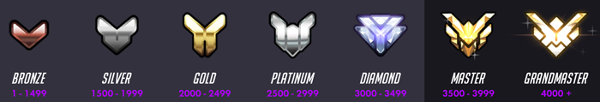
Competitive Ranking System
Players play 10 placement matches.
Players are assigned a skill rating based on their wins/losses, and performance in those games.
Players gain or lose points based on wins and losses.

Slide 4
The Problems
Parts of the Overwatch community have become toxic.
Too many people are insulting and mean.
People blame others wrongly for their losses.
Players claim to be better than they are with characters, and refuse to switch or give up your main character.

Slide 5
The Solutions
A way to look up users who call others out and insult people.
Our service will show players’ average stats, totals, and game highs.
This service would include a head to head comparison feature.
Our last feature will be a character by character comparison.

Slide 6
The Process
We started out thinking about the ways we could solve the problem.
At first our thinking was simple, but we wanted to give users more options.
We added more search and compare options to accomplish this goal.
We came up with more problems to solve by playing the game.

Slide 7
Design
For the design, we went simple, similar to a material design.
We intentionally avoided services like Bootstrap in order to increase our knowledge of CSS.
We used CSS, and JavaScript, and PHP to make tables, a nav bar, a banner, etc.
Our color scheme ended up being a soft grey background, purple nav bar, different shades of black and grey for the tables, with white text all around.

Slide 8
Implementation
In order for this project to work, we had to use the LootBox API.
This allowed us to get data about users and put them into tables.
The tables are generated upon search, based on the type of search.
We used JavaScript, PHP, and JSON to make this possible.

Slide 9
Implementation Details
We used PHP and JavaScript to generate HTML tables which displays the requested data from the API.
This caused our code to become modular so we didn’t have to repeat HTML.

Slide 10
Design/Implementation Challenges
Lack of Bootstrap.
Lack of any outside frameworks besides Lootbox.
Server certificate issues.
Git.
Time management.

Slide 11
Partner Roles
Nathan:
  Implementation of LootBox API
  Majority of HTML, JavaScript, and PHP
  Consulted on CSS and design
  Consulted on write up
  Consulted on presentation
  Application feature design
CJ:
  CSS and design
  Some HTML
  Some PHP
  Application feature design
  Consulted on JavaScript and PHP

